Slide 1

Simple Attendance Tracker Using Python
Welcome to the world of effortless attendance tracking! Discover the power of Python with our simple attendance tracker and revolutionize the way you monitor and analyze attendance data.

Slide 2
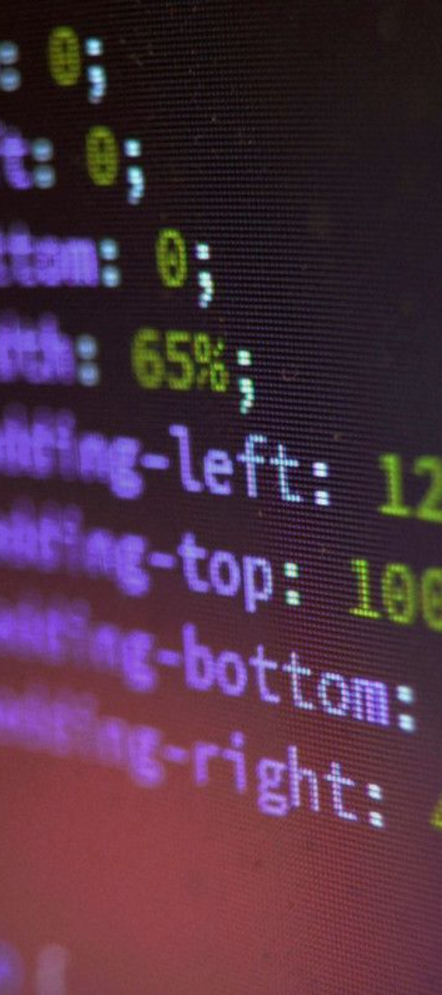
Benefits of a Simple Attendance Tracker
Time and Effort Saving
Accuracy and Reliability
Say goodbye to manual attendance tracking and automate the process with just a few clicks.
Remove the risk of human error and ensure accurate attendance records every time.
Data Analysis Made Easy
Effortlessly analyze attendance trends, identify patterns, and make data-driven decisions.

Slide 3

Key Features of our Attendance Tracker
1
Data Input & Storage
Seamlessly input and store attendance data using our intuitive user interface and reliable database.
2
Attendance Monitoring
Real-time monitoring of attendance with notifications and alerts for better attendance management.
3
Reports & Analysis
Generate comprehensive reports and perform in-depth analysis for actionable insights at your fingertips.

Slide 4
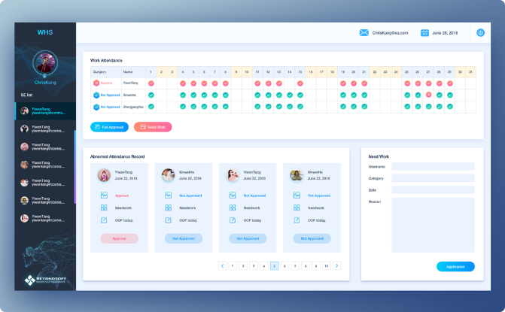
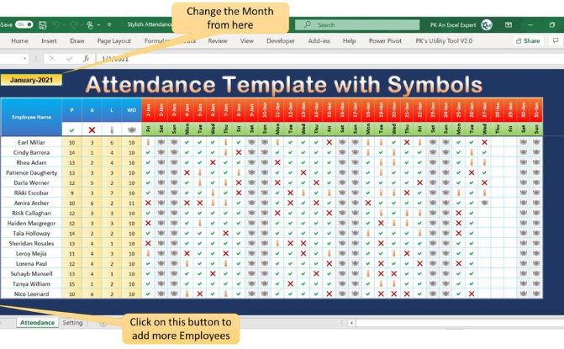
Demonstration of our Attendance Tracker
User Interface & Interaction
Inputting & Retrieving Attendance Data
Experience a user-friendly interface designed for seamless navigation and effortless attendance tracking.
Efficiently input attendance records and retrieve data at any time with just a few simple steps.

Slide 5

Conclusion & Next Steps
Recap of Benefits & Features
Adopt & Customize Today
Remind yourself of the numerous benefits and key features our attendance tracker brings to your fingertips.
Start using our attendance tracker now and tailor it to your specific requirements for maximum efficiency.

